Slide 1
Why Threads :
Responsiveness (web application) : Concurrency = multitasking
One core can handle multiple threads.
Performance: Parallelism
How OS execute application:
Access file from disk and create instance of application in memory
Reference : https://developer.ibm.com/tutorials/l-completely-fair-scheduler/
Memory
CPU
Instance Of application
Operating System
Disk / Hard Drive
Instance of application we called as
Process ( Context)
Application 1
Photo
Music Player
Application 2

Slide 2
Thread Architecture:
Single Thread
Multiple Thread
Process (Context)
Process (Context)
PID Mode
…
…
…
Priority
Files
PID Mode
…
…
…
Priority
Files
Thread 1
Main Thread
Main Thread
Thread 1
Stack
Stack
Stack
Data
(Heap)
Data
(Heap)
Instruction point
Instruction point
Instruction point
Code
Code
Shared by all threads
Stack: Region in memory where local variable are stored and passed into functions
Instruction Pointer: Address of the next instruction to execute.

Slide 3
Context Switch:
Stop Thread 1
Schedule thread 1 out
Schedule thread 4 in
Start thread 4
Process ID 10
Process ID 20
Process ID 30
Process ID 10
Process ID 20
Process ID 30
Thread 1
Thread 2
Thread 1
Thread 2
Thread 1
Thread 1
Thread 2
Thread 1
Thread 2
Thread 1
Thread 3
Thread 4
Thread 3
Thread 4
Thread 1
Thread 4
CPU
CPU
Context Switch Cost:
Context switch is not cheap, ant is the price of multitasking ( concurrency)
Same as human when we multitask- Takes time to focus
Each thread consumes resources in the CPU and memory
Context switch involves storing data for one thread, and restoring data for another thread.

Slide 4
Threads Schedule:
Arrival Order | Length
1
2
3
4
Music Player
PID 10
Text Editor
PID 20
File Save Thread
Music player Thread
Music player Thread
Music Player User interface Thread
File Save Thread
Text Editor User interface Thread
Text Editor User interface Thread
Music Player UI Thread
File Save Thread
Music player Thread
First Come First Serve
Problems:
Long thread can cause starvation.
Many cause User interface thread being unresponsive – Bad User experience.
Text Editor User interface Thread
Music Player UI Thread
Text Editor User interface Thread
Music Player UI Thread
Music player Thread
File Save Thread
Shortest JOB First
Problems:
Since always schedule shortest JOB, every time new shortest job get priority. Very least chance to longer jobs
If longer job stared again other jobs needs wait till longer job completed.

Slide 5
Threads Schedule Cont.. :
Time Slices ( Epoch )
Operating system create time slots named as Epoch and allocate some time to each thread inside Epoch.
Not all thread will RUN or COMPLETED in each Epoch.
It use DYNAMIC PRIORITY to priority thread.
DYNAMIC PRIORITY = Static Priority + Bonus
Bonus can be negative.
Bonus is adjusted by the OS in every Epoch for each thread.
Static priority set by the developer programmatically.
Using dynamic priority the OS will give preference for interactive threads ( user interface threads)
OS give preference to threads that did not complete in last epoch or did not get enough time to run.
EPOCH 1
EPOCH 2
File Save Thread
Music Player UI Thread
Music player Thread
Text Editor User interface Thread
File Save Thread
Text Editor User interface Thread

Slide 6
Thread Vs Processes:
Multi Thread
Multi Process (Microservices)
Process (Context)
Process 1 (Context)
Process 2 (Context)
PID Mode
…
…
…
Priority
Files
Thread 1
PID Mode
…
…
…
Priority
Files
Main Thread
PID Mode
…
…
…
Priority
Files
Main Thread
Main Thread
Stack
Stack
VS
Stack
Stack
Data
(Heap)
Data
(Heap)
Data
(Heap)
Instruction point
instruction point
Instruction point
Instruction point
Code
Code
Code
Prefer if task share lot of data.
Threads are much faster to create and destroy.
Switching between thread of the same process is faster (shorted context switches)
Security and stability are of the higher importance.
Tasks are unrelated to each other.

Slide 7
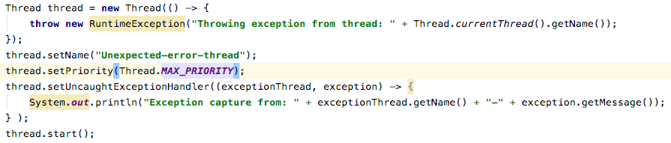
Thread:
Thread class – Encapsulate all thread related functionality.
Two ways to run code on new thread:
Implement Runnable interface and pass to new Thread object.
Extend Thread class and create an object of that class.
Thread Features:
Can set thread name
Can set thread priority.
Set Uncaught exception handler

Slide 8
Threads Termination: Why and When
Even threads are not in running status threads consume resources
Memory and kernel resources.
CPU cycles and cache memory
If thread finish it work, but application is still running, we want to clean up the thread’s resource.
If a thread is misbehaving, we want to stop it.
The application will not stop as long as at least one thread is still running.
Thread.interrupt()
If thread is executing a method that throws and InterruptedException
If the thread code is handling the interrupted signal explicitly.
Reference : ThreadInterruptedCheck.java
Daemon Thread
Background threads that do not prevent the application from exiting if the main thread terminates.
Scenario 1
Background tasks, that should not block our application from terminating.
Ex: File Saving thread in a text editor.
Scenario 2
Code in a worker thread is not under our control, and we do not want it to block our application from terminating.
Ex: Worker thread that uses an external library.
To convert thread to Daemon thread: “thread.setDaemon(true)”
Reference: ThreadInterruptedCheck.LongComputationDaemonTask.java

Slide 9
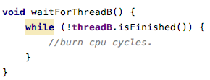
Thread Coordination (join):
Possible Thread execution Order
Why Thread Coordination:
One thread depends on other
Different threads running independently.
Order of execution is out of control.
Thread Execution scenario 1
Thread Execution scenario 2
Thread A
Thread B
Thread B
Thread A
Thread Execution scenario 3
Thread Execution scenario 4
Thread A
Thread A
Thread B
Thread B
Thread A
Thread Coordination: Native solution
Thread A runs in a loop in a loop and keeps checking thread B’s result is ready
WASTE
WASTE
WASTE
Thread A
Check
Thread B
Doing work
Thread A
Check
Thread B
Doing work
Thread A
Check
Thread B
Doing work

Slide 10
Thread Coordination (join) Cont…:
Thread Coordination: Desired solution
Thread A runs in a loop in a loop and keeps checking thread B’s result is ready
We can use
public final void join()
public final void join(long miles, int nanos)
public final void join(long miles)
Reference: JoinCheck.java
Advantages:
More control over independent threads.
Safely collect and aggregate results.
Gracefully handle runaway threads using Thread.join(timeout)
Thread A check and goes to sleep
Thread A Wakes up
Thread A
Thread B Doing work and complete
Thread A get result

Slide 11
Performance in multi threading:
Performance metrics depends on the use cases.
Latency: The time to completion of a task measured in times unit. ( Trading application)
Throughput: The amount of task completed in a give peridot. Measured in task / time unit.
Latency
TASK 1
TASK
TASK 2
Latency = T
TASK N
Latency = T/N
Theoretical reduction of latency by N = Performance improvement by a factor of N
Here N = number of cores (OS Manage context switch properly.)
Condition: # thread = # of cores is optimal only if all threads are runnable and can run without interruption. (no I/O blocking calls / sleep etc)
Assumption is nothing else running that consumes lot of CPU
Reference: LatencyCheck.java
TASK 1
CORE 1
TASK 2
CORE 2
TASK N
CORE N

Slide 12
Inherit cost of Parallelization and Aggregation:
Breaking Task into multiple tasks
Time until the aggregation thread runs
Thread Creation, passing tasks to thread
Aggregation of the sub result into a single artifact
Time between Tthread.start() to thread getting scheduled
Time unit the last thread finishes and signals

Slide 13
Performance in multi threading Cont…:
Throughput
Throughput is the number of tasks completed in a given peridot.
Measured in # tasks / time unit.
Best way to achieve: running tasks in paroral
Suitable for:
Tasks which are not interdependent ( one task no need to wait completion of another task)
Reference: ThroughputCheck.java
Thread Pool:
JDK comes with few implementation of thread pool
Fix Thread pool executor.
Thread Pool
Thread 1
Thread 2
TASK
Thread 3
Thread 4

Slide 14
Data Sharing Between Threads.
Stack:
Memory Region where
Method are called.
Arguments are passed.
Local variables are stored.
Stack + Instruction pointer = State of each threads execution.
Stack Memory allocation workflow:
Stack
void main(String[] args) {
int x = 1;
int y = 2;
int result = sum(x, y);
}
int sum(int a, int b) {
int s = a + b;
return s;
}
Sum Stack
s = 3
b = 2
a = 1
Main Stack
Result = 3
y = 2
x = 1
args

Slide 15
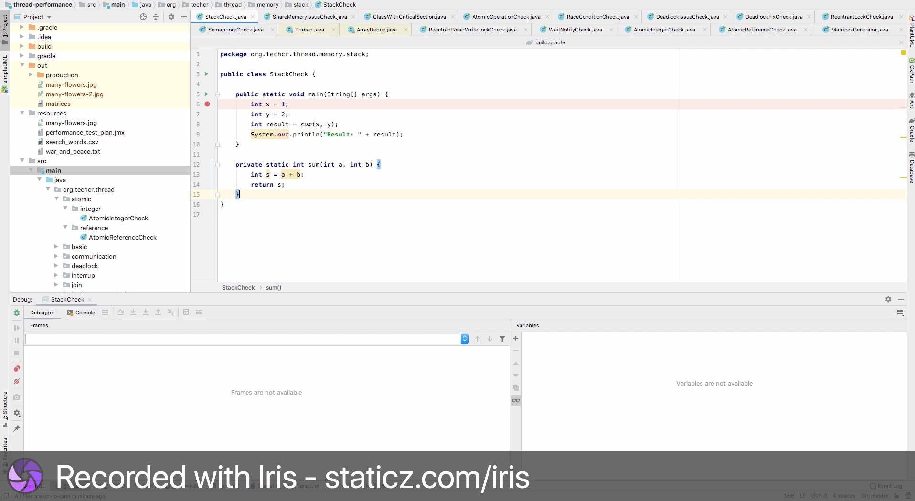
Stack Behavior demonstration ( Idea debugging) – play video
Stack’s properties
All variables belongs to the thread executing on that stack.
Stack, statically allocated when thread is created.
The stack size is fixed and relatively small (platform specific)
If calling hierarchy is too deep we may get an StackOverflow exception.

Slide 16
Heap:
What is allocated in HEAP:
Object (anything created with the new operator.)
Members of class.
Static variables. ( class members )
HEAP memory management:
Governed and managed by Garbage collector.
Objects – stay as long as we have reference to them.
Members of classes – exist as long as their parents.
Static variables: stay for ever.

Slide 17
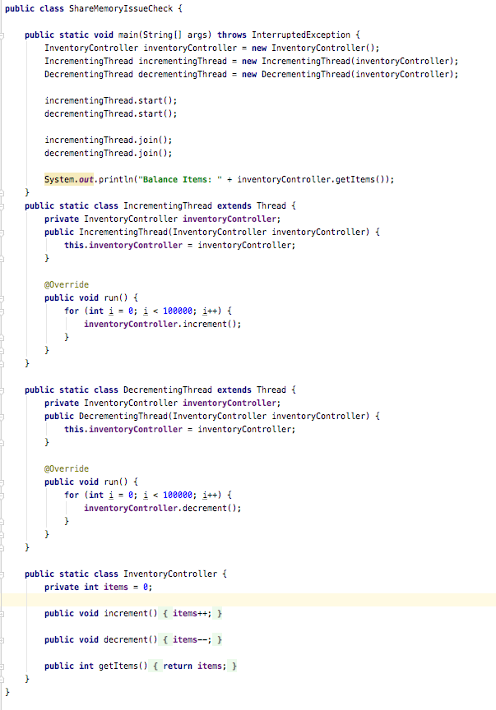
Resource share between threads:
What is resources:
Variables (Integers, Strings )
Data structure.
File or connection handlers.
Message or work queues.
Any Objects.
Resource share between threads - Problems:
Execute class: ShareMemoryIssueCheck.java
You can monitor input is not stable. Its change time to time.
Because InventoryController is shared object (not atomic).
The item numbers shared between two threads.
Item++ and item– are happening in same time. Not atomic operations.
Possible execution path: (race condition)
Increment Thread
Decrement Thread
1. currentVal <- items = 0
2. newVal <- currentVal + 1 = 1
3. currentVal <- items = 0
4. newVal <- currentVal - 1 = 0
5. items <- newVal = -1
6. items <- newVal = 1
Items = 1
Notes:
Atomic Operations:
An operation or set of operations is considers atomic, if it appears to the rest of the system as if it occurred at once
Single step – “all or nothing”
No intermediate state.

Slide 18
The concurrency
Synchronize - Monitor:
Synchronize is applied for object. Thread B cant access method since Thread A utilize lock.
Thread A
public class ClassWithCriticalSection { public synchronized void methodA() { } public synchronized void methodB() { } }
Thread B
Synchronize - Lock:
Create object and lock it in critical sections
public class ClassWithCriticalSection { Object lock1 = new Object(); public void methodA() {
……..
……..
…….. synchronized(lock1) {
Critical section
}
……..
……..
…….. } }
public class ClassWithCriticalSection { Object lock1 = new Object();
Object lock2 = new Object(); public void methodA() { synchronized(lock1) {
…
} } public void methodB() { synchronized(lock2) {
…
} } }
Concurrent execution
Thread A
Non Concurrent execution
Thread B
Concurrent execution
Reference: ClassWithCriticalSection.java

Slide 19
Issues with Synchronization
No Paroral execution. Worst situation than single thread ( CPU usage, context switch, memory usage )
Running
Suspended
Running
Suspended
Running
Suspended
Running
Suspended
Running
Suspended
Suspended
Running
Suspended
Suspended
Running
Suspended
Running
Suspended
Desired Execution:
Running
Running
Running
Running
Running
Running
Running
Running
Running
Running
Running
Running
Running
Running

Slide 20
Atomic Operations:
All reference assignments are atomic.
We can get and set references to objects atomically. (getters and setter are atomic because it refer reference of object. this.setName = name )
Object a. = new Object();
Object b = new Object();
a = b //atomic
All assignment for primitive types. Expect long and double.( long and double 64 bits)
Variable defined as volatile.
volatile double x = 1.0;
volatile double y = 2.0;
x = y; //atomic
Classes in the java.util.concurrent.atomic package.
Reference: AtomicOperationCheck.java
Upper 32 bits
Lower 32 bits
x.lower_32_bits y.lower_32_bits
Long / double
X = Y
x.upper_32_bits y.upper_32_bits

Slide 21
Race Conditions:
Condition when multiple thread are accessing a share resource.
At least one thread is modifying the resource.
The timing of thread scheduling may cause incorrect results.
The core of the problem is non atomic operation performed on the shared resource.
Race Conditions - solution:
Identification of the critical section where the race condition is happening.
Protection of the critical section by a synchronized block.
Data Race
Executors not follow specified procedure in code.
Compiler and CPU may execute the instruction out of order to optimize performance and utilization.
They will do so while maintain the logical correctness of the code.
Out of order execution by the compiler and CPU are important features to speed up the code.
The compiler rearrange instruction for better
Branch prediction ( optimized loops, if statement, etc..)
Vectorization – parallel instruction execution.
Prefetching instructions – better cache performance.
CPU re-arrange instructions for better hardware units utilization.
Reference: RaceConditionCheck.java
Data Race Solutions
Establish a Happens - Before semantics by one of these methods:
Synchronization of methods which modify shared variables.
Declaration of share variables with the volatile keyword.

Slide 22

Locking & Deadlocks.
Fine-grained Locking
Individual LOCK for every shared resource.
This will let threads to access shared resources same time
This let thread to smooth run. Desired Execution :
Coarse-Grained Locking
One single LOCK for all the shared resources.
Very simple to maintain.
This will block whole object. Any other thread cant access any other resource.
Reference : Issues with Synchronization
public class ClassWithCriticalSection { Object lock1 = new Object();
Object lock2 = new Object(); public void methodA() { synchronized(lock1) {
…
} } public void methodB() { synchronized(lock2) {
…
} } }
Thread A
Thread A
public class ClassWithCriticalSection { public synchronized void methodA() { } public synchronized void methodB() { } }
Thread B
Thread B

Slide 23

Deadlock:
This is the state where “IF YOU MOVE FIRST I WILL MOVE”
Possible Execution Order
Thread 1
lock(A)
lock(B)
delete(A, item)
add(B, Item)
unlock(B)
unlock(A)
Thread 2
lock(B)
lock(A)
delete(B, item)
add(A, Item)
unlock(A)
unlock(B)
Thread 1
Thread 2
1. Lock A
2. Lock B
3. Lock A
4. Lock B
DEADLOCK
Conditions for Deadlock: Reference: DeadlockIssueCheck.java
Mutual exclusion – only one thread can have exclusive access to resource.
Hold and Wait – at least one thread is holing a resource and waiting for another resource.
Non-preemptive allocation – a resource is released only after the tread is done using it.
Circular wait – a chain of at least two threads each one is holding one resource and waiting for another resource.
Solution for Deadlock: Reference: DeadlockFixCheck.java
Avoid circular wait – enforce a strict order in lock acquisition.
Dead lock detection
WatchDog – update registry in every operation. If registry not get updated deadlock occurred.
Thread interruption and tryLock operations (not possible with synchronize)
Thread 1
lock(A)
lock(B)
delete(A, item)
add(B, Item)
unlock(B)
unlock(A)
Thread 2
lock(A)
lock(B)
delete(B, item)
add(A, Item)
unlock(B)
unlock(A)

Slide 24
Lock Types:
ReentrantLock:
Same functionality and properties as synchronize block.
Unlike synchronize block this lock needs locking and unlocking.
Provide more control and advance features.
Query methods for testing lock’s internal status. (# of thread waiting, current thread etc..)
getQueuedThreads() – Returns a thread of list waiting to acquire a lock.
getOwner() – Returns the thread that currently owns the lock.
isHeldByCurrentThread() - Quires if the lock is held by the current thread.
isLocked() – Quires if the lock is held by any thread.
Lock interpretability
Helpful for
Watchdog for deadlock detection and recovery.
Waking up thread to do clean and close the application.
tryLock()
Returns true and acquires a lock if available.
Returns false and does not get suspended if the lock is unavailable.
Regardless of the state of lock, it always return immediately
Avoid blocking the real time thread.
Keep application responsive.
Performed operation automatically.
Reference : ReentrantLockCheck.java
Lock
public class ClassWithReetrantLock {
Lock lock1 = new ReentrantLock(); public void methodA() { lock1.lock(); // Lock
try {
.. Do operation
} finally {
lock1.unlcok(); //Unlcok
} } }
Synchronized Block
public class ClassWithSynchronized {
Object lock1 = new Object(); public void methodA() { synchronized(lock1) { // Lock
.. Do operation
} //Unlcok } }
Reentrant lock
public class ClassWithReetrantLock {
Lock lock1 = new ReentrantLock(); public void methodA() { lock1.lock(); // Lock
.. Do operation
lock1.unlcok(); //Unlcok } }
In case exception throws or return a value before unlock unlock wont happen. So must use unlock in side finally clause.
Lock interpretability
While(true) {
try {
lock1.lockInterruptibily();
} catch(InterruptedExcepction e) {
clenaupAndExit();
}
}
1. someThread.interrupt()
2. If thread interrupted, execute cleanup and exit from thread.
Lock
public class ClassWithReetrantLock {
Lock lock1 = new ReentrantLock(); public void methodA() { lock1.lock(); // Lock
try {
.. Do operation
} finally {
lock1.unlcok(); //Unlcok
} } }
Try Lock
public class ClassWithReetrantLock {
Lock lock1 = new ReentrantLock(); public void methodA() { if( lock1.tryLock()) {; // Lock
try {
.. Do operation
} finally {
lock1.unlcok(); //Unlcok
} } else { …….} }
Not like lock, try lock return Boolean, base on that with out waiting can continue on work.

Slide 25
Lock Types Cont… :
Reentrant Read Write lock:
For multiple and faster reads than one write. ( caching read / write ) this will allow for concurrent read threads but only one write thread in critical area.
When the read operations are not as fast,
Read from many variables
Read from complex data structure.
Mutual expression of regarding threads negatively impacts the performance.
Multiple read thread allows, but only one writer thread allowed.
Support two method, readLock() and writeLock()
If one read hold lock write cant write, its needs to wait till read lock release the lock.
Reference : ReentrantReadWriteLockCheck.java
Lock
Waiting Queue
Waiting Queue
Reader Lock
Writer Lock
Reader 1
Reader 2
Writer 1
Cache
Reader 1
Writer 1 release lock
Reader 1
Writer 2
Reader 2
Writer
Reader 2
Reader 3
Readers release lock
Reader 3
Writer 2
Reader 4

Slide 26
Inter thread communication:
Semaphore: Ref: SemaphoreCheck.java
Can be use to restrict the number of “users” to a particular resource or group of resource.
Unlike the locks that allows only one ”user” per resource. The semaphore can restrict any given number of users to a resource.
Example use case : Parking Lot, if parking lot fully utilized cant offer parking parse to another car, but when slot available issue car pass.
Thread can acquire more permits just calling semaphore.acquire(x), also semaphore.release(x), is releasing # of permits.
Semaphore is different from lock
Semaphore doesn't have a notion of owner thread. ( no owner thread concept)
Many threads can acquire a permit. (by calling semaphore.acquire(x))
The same thread can acquire the semaphore multiple times.
The binary semaphore (initialize with 1 – semaphore.acquire(1)) is not reentrant. Because thread will block with first call
Semaphore can be released by any thread.
Even can be release by a thread that hasn’t actually acquired it.
Mostly suitable for Producer Consumer implementation.
Waiting
Car 1
Car 2
Car 3
Car 4
Car 9
Car 5
Car 6
Car 7
Car 8
Car 2 and Car 5 leaved
Car 1
Vacate
Car 3
Car 4
Vacant
Car 6
Car 7
Car 8
Car 9 got slot, one slot free for next
Car 1
Car 9
Car 3
Car 4
Vacant
Car 6
Car 7
Car 8

Slide 27
Threads Signaling
The object class contains the following methods:
public final void wait() throws InterruptedException. public final void notify()
public final void notifyAll()
Every java class inherits from Object class. This gives us the power to use any given object as a condition variable and lock (using the synchronized keyword)
wait() - – causes the current thread to wait until another thread wakes it up.
In the wait state, the thread is not consuming any CPU.
Two ways to wakeup the waiting thread.
notify() – wakes up a single thread waiting on that object. (if multiple thread waiting on that object one of them will choose by arbitrary)
notifyAll() – wakes up all the threads waiting on that object.
To call wait(), notify() and notifyAll() we need to acquire the monitor of that object. (use synchronized on that object)
Reference : WaitNotifyCheck.java
Thread.Interrup()
Thread A
Thread B
Thread.Interrup()
Cleanup and terminate
Thread.join()
Thread A
Thread B
thread.join()
Wakeup thread A

Slide 28
Lock free algorithms, Data structures & Techniques.
Issues with lock :
Deadlock
deadlock are generally unrecoverable.
Can bring application to a complete halt.
The more locks in the application, the higher the chances for a deadlock.
Multiple thread using the same lock.
One thread holds the lock very long time.
That thread will slow down all the other threads.
All threads become as slow as the slowest thread.
Two threads sharing a lock
Low priority thread ( file saver)
Hight priority thread (UI)
Low priority thread acquire the lock and is preempted. (scheduled out)
Hight priority thread cannot progress because of the low priority thread is not scheduled to release the lock
Thread not release a lock
Thread dies, gets interrupted or forgets to release a lock.
Leaves all the thread hanging forever.
To avoid this developers needs to write more complex code.
Performance overhead in having contention over a lock.
Thread A are acquire a lock.
Thread B trying acquire a lock and get block.
Thread B is scheduled out. (context switch)
Thread B is scheduled back (context switch)

Slide 29
Lock Free Techniques.
Why we need locks.
Multiple threads accessing shared resources.
At least one thread is modifying the shared resources.
Non atomic operations.
Non atomic operation on one shared resource.
A single java operation turns into one or more hardware operations.
Example : counter++ turns into 3 hardware operations.
Read Count
Calculate Value
Store new value to count.
Lock Free Solution.
Utilize operations which are guaranteed to be one hardware operation.
Single hardware operation is
Atomic by definition.
Thread safe.
Java Lock free examples.
AtomicIntegerCheck.java
AtomicReferenceCheck.java

